Slide 1

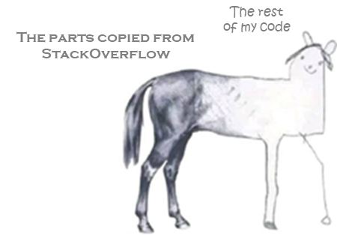
Game Maths & Physics
Vectors
Part 1
Introduction
ChatGPT

Slide 2

How to define space?
Common game programming problems
Cartesian coordinate systems
Space and movement
What is a vector?
Vector representation in code
Unity Vector classes

Slide 3

Many of you will have covered vectors and matrics in school, but the focus here is on how to solve game-related problems using vectors in your code.
We won’t go into lots of examples, like at school. Vectors are quite straightforward, so even if you haven’t seen them before it won’t be a disadvantage. What is more important is your programming!

Slide 4
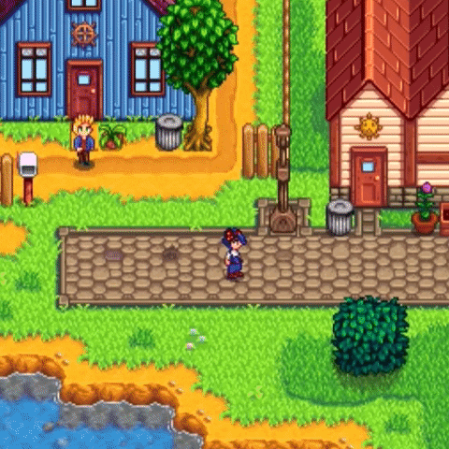
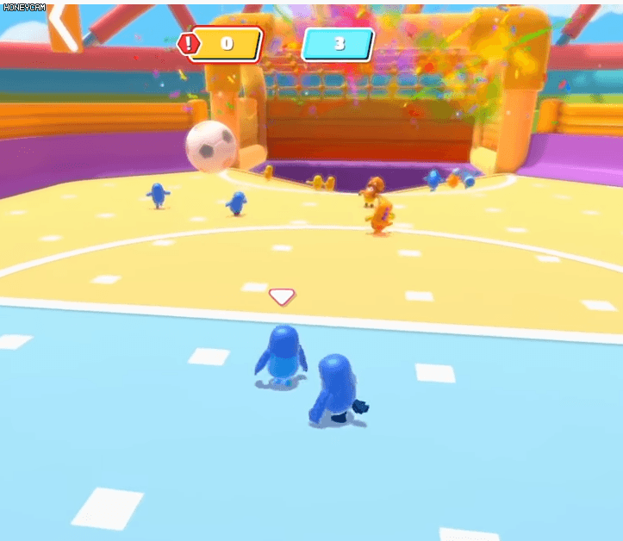
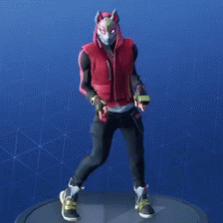
Before we get started …
… game worlds exist in either 2D or 3D space.
But how can we describe space logically, so that we can program these game worlds and everything that happens in them?
Hint: it’s all math!

Slide 5
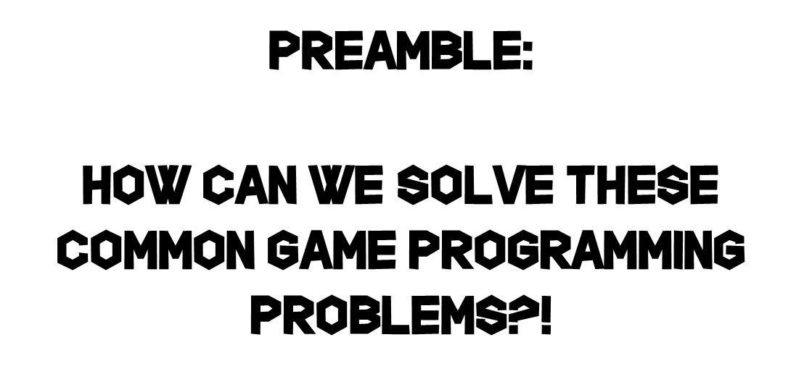

Slide 6


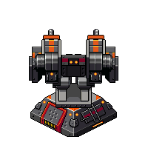
1. Find the direction and distance between two points?
2. Find the angle between two directions?
Desired direction
Angle to rotate
Current direction of turret

Slide 7
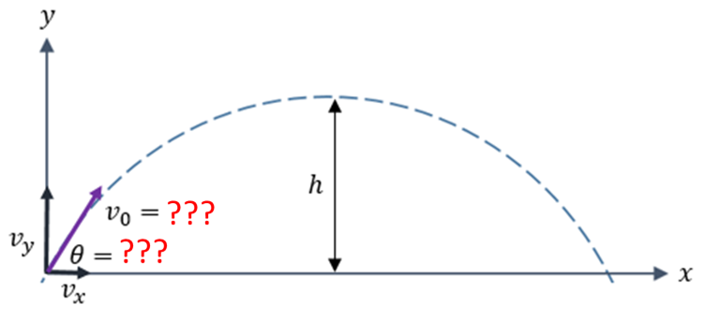
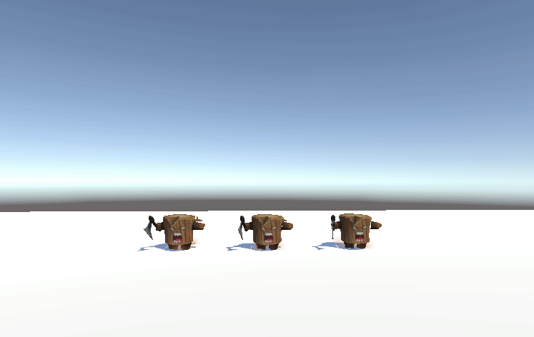
3. Calculate a projectile’s velocity and angle to hit a target?
4. Make a better jump?

Slide 8
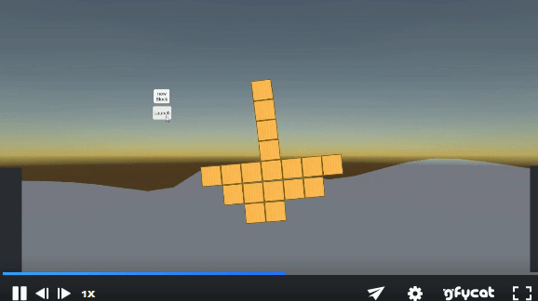
5. Decide if the player should be able to go up a slope or not?
go up
slide down
6. Simulate an object floating in water?

Slide 9
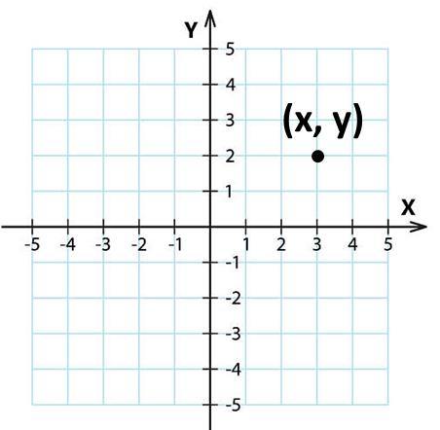
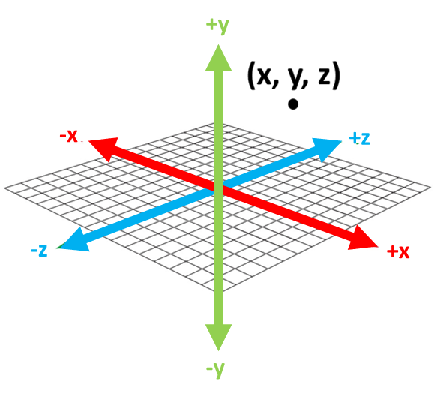
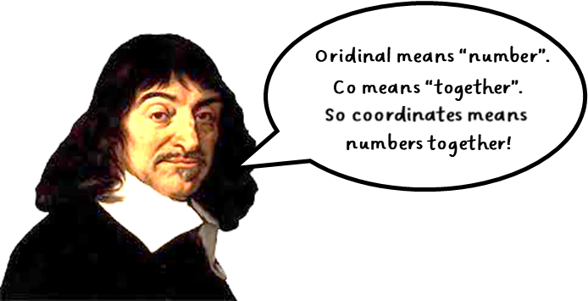
To start, let’s go back a few hundred years
A point in 2D space is represented by TWO coordinate components
A point in 3D space is represented by THREE coordinate components
Note: there are other coordinate systems (like polar coordinates), which we won’t look at now.
Even for cartesian systems, things can get complicated …

Slide 10

Various coordinate systems are used in computer graphics
2D
3D left handed
3D right handed
???
For historical reasons, the screen origin is at top left.
Left hand
Right hand
DirectX
Unity
OpenGL Maya
So for many 2D graphics libraries, you will often find that the Y axis points down.

Slide 11


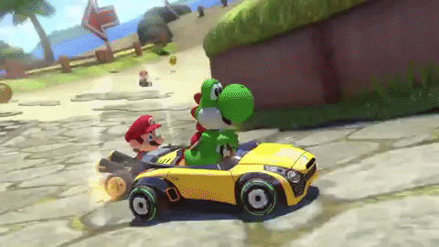
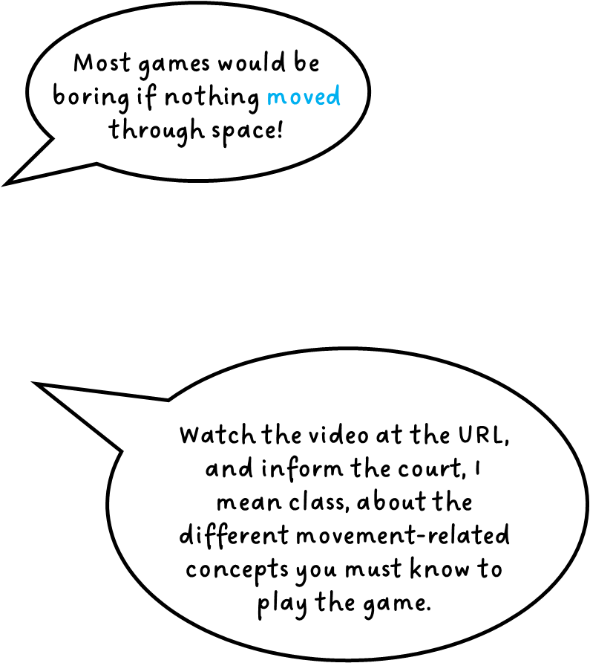

https://youtu.be/pgsU0FC1hfA
Add your answer to this padlet
https://tinyurl.com/yke4e2jb
5 minutes
Notes:
Students should respond with thing like: speed, velocity, acceleration, direction/steering, distance, etc.
This is just to prime them for the next few slides, which cover these concepts.

Slide 12


Slide 13
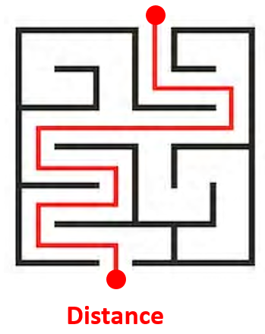
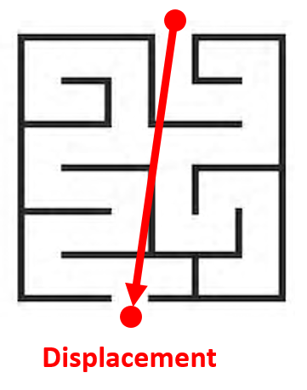
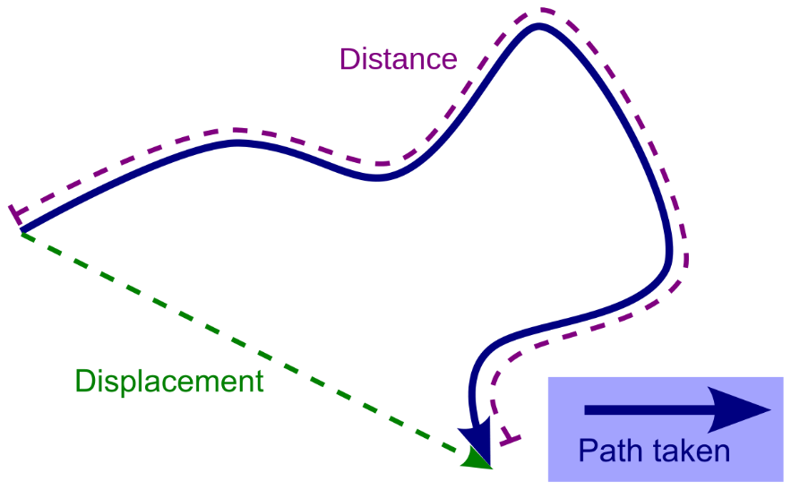
Distance
A measure of the interval between two locations measured along the actual path connecting them. Distance is not along a specific direction.
Displacement
A measure of the interval between two locations measured along the shortest path connecting them.
Displacement is along a specific direction.

Slide 14
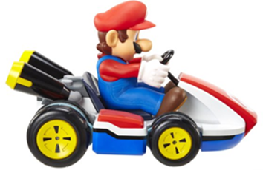
Speed
Speed is the rate of change of distance with time.
distance
distance
distance
distance
time
time
Speed does not specify direction of movement.

Slide 15
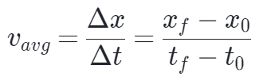
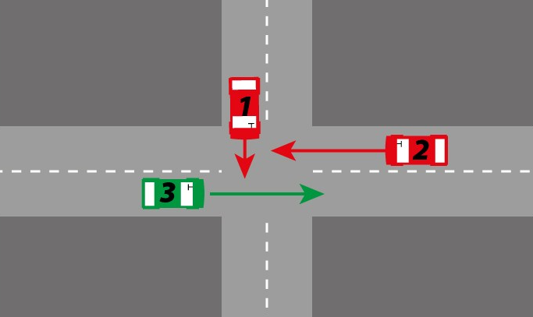
Velocity
Velocity is the rate of change of displacement with time.
Velocity includes magnitude and direction of movement.
We won’t go over the difference between average and instantaneous velocity, since you should remember this from school. If not, look here.

Slide 16
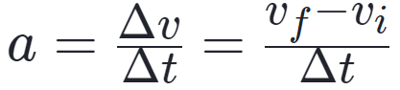
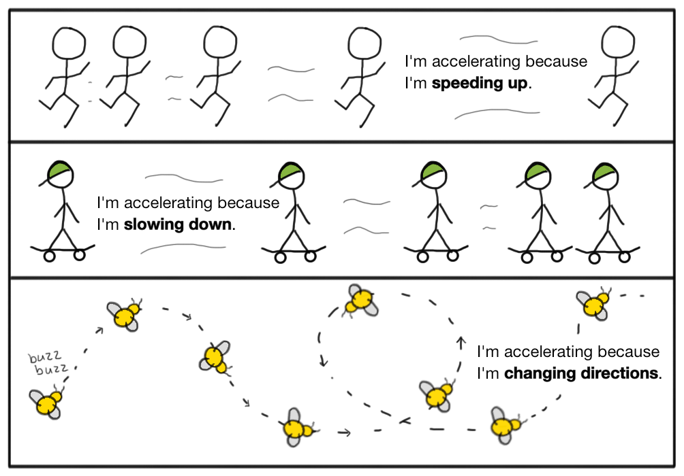
Accelleration
Accelleration is the rate of change of velocity with time.
Accelleration includes magnitude and direction of movement.
A change of direction is also a change in velocity. If velocity changes, then this is an accelleration
We won’t go over the difference between average and instantaneous accelleration, since you should remember this from school. If not, look here.
https://www.khanacademy.org/science/physics/one-dimensional-motion

Slide 17
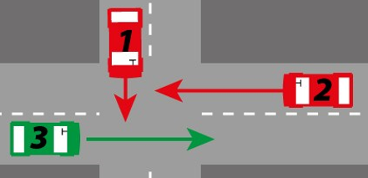
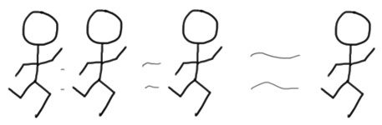
Distance and speed do not include any information about direction.
They are just numbers.
distance = 25m
speed = 30km/h
But displacement, velocity, and acceleration do have information about direction.
e.g. car2 is moving 10 mph to the left, car 3 is moving 20 mph to the right.
Any quantity that includes direction cannot be represented by a single number. So, how do we include this direction information more formally?

Slide 18
Scalars vs. Vectors
y
y
This is a position vector, which represents the position of a point in space (rooted at the origin)
7
7
Vector from the origin to (5, 4)
6
What does this mean?
6
5
5
4
(5, 4)
4
(5, 4)
3
3
2
2
Then move 4 units along the y axis
1
1
x
x
1
2
3
4
5
6
7
1
2
3
4
5
6
7
Move 5 units along the x axis
Moving along an axis involves direction.
Vectors can be used to describe an object’s motion (speed and direction).
This means moving along a vector.
Vectors in games also represent displacement, velocities, or force.
A vector has both magnitude and direction.

Slide 19
Vectors only have magnitude and direction.
They do not have position.
D
A
C
A
B
So both arrows labelled A represent the same vector!

Slide 20
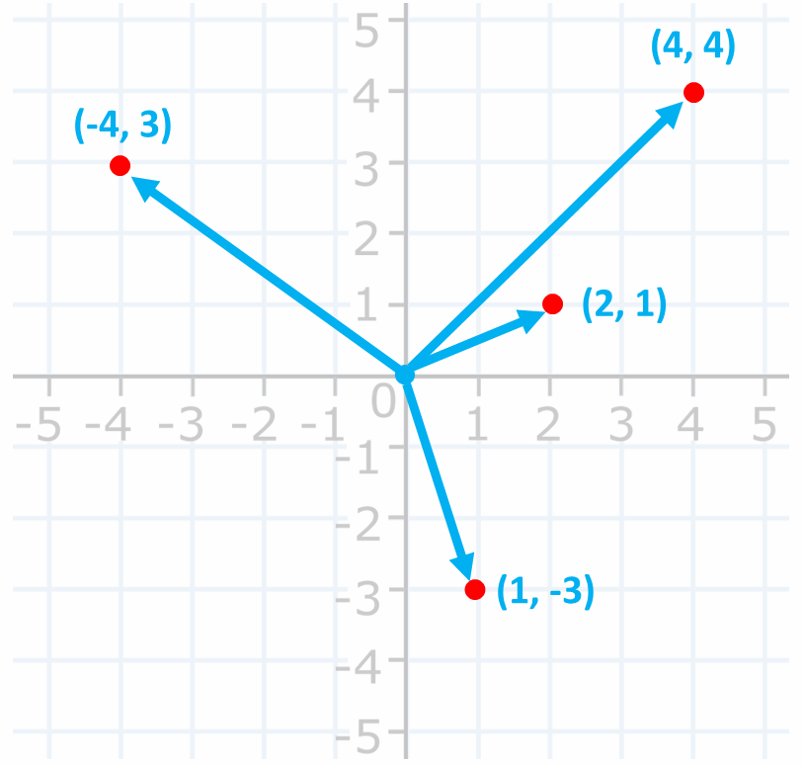
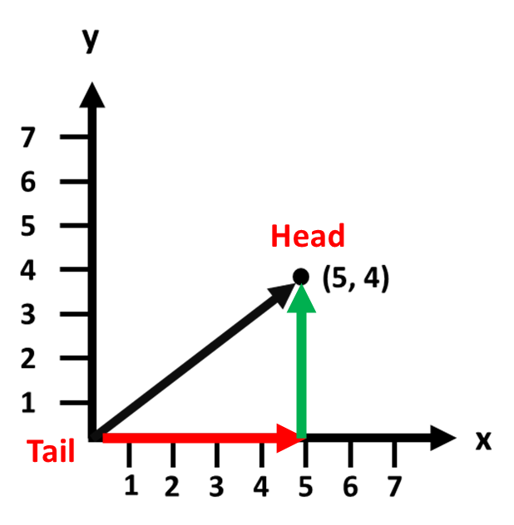
But a point can be represented by a vector, if we specify that the tail of the vector is at the origin

Slide 21

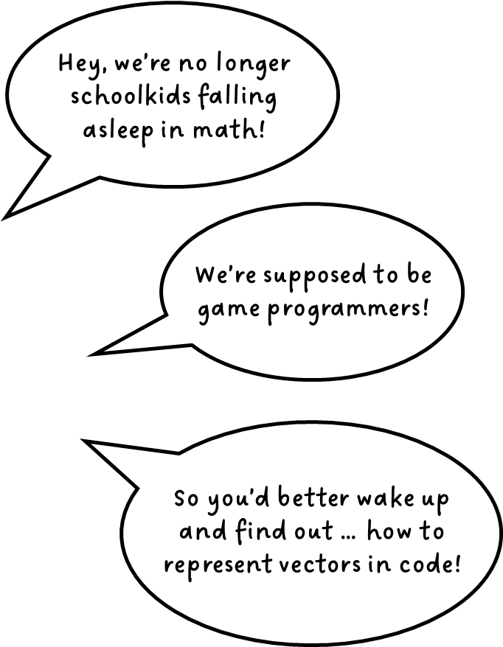

5 minutes
https://tinyurl.com/yke4e2jb

Slide 22
Vector notation in math
In bold font
a =
AB
B
A

Slide 23
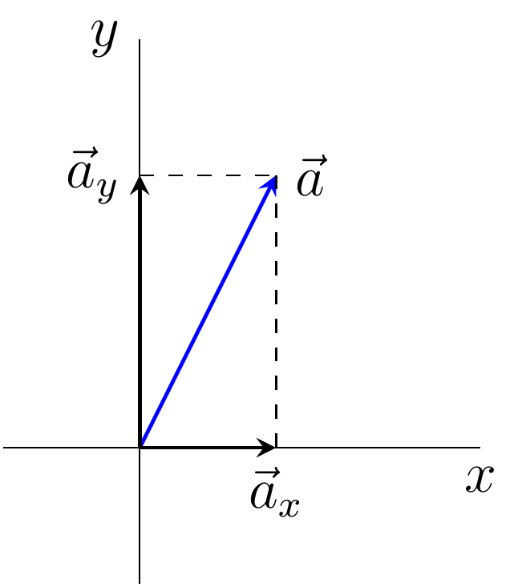
Representing vectors in code
Remember, programming is all about the manipulation of data.
So, what data do we need to to represent a vector?
Vector a
The data we need to store are the x and y components of a
The y component of a
a_{x}
a_{y}
For 3D vectors, we add a value for the z axis
a_{x}
a_{y}
a_{z}
The x component of a
https://commons.wikimedia.org/wiki/File:Vector_in_2D_space_and_its_decomposition.png

Slide 24
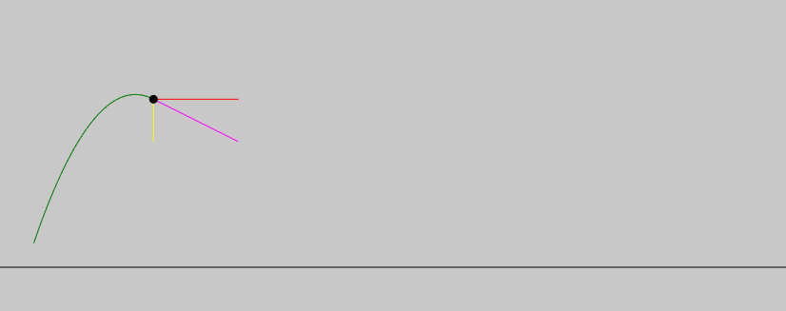
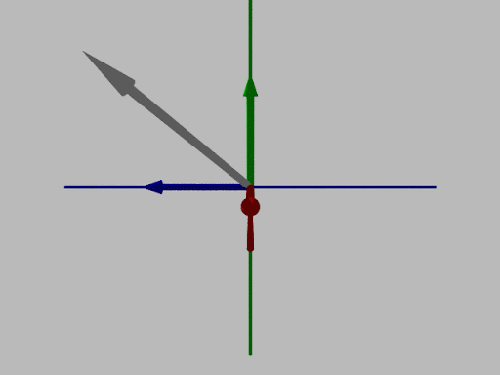
Vectors are decomposed into values along the coordinate axes
http://zonalandeducation.com/mstm/physics/mechanics/vectors/vector3D/vector3D.html
http://zonalandeducation.com/mstm/physics/mechanics/vectors/components/vectorComponents.html

Slide 25
In code, this data can be stored in:
An Array of floats
float [ ] vector2D = new float[2];
A struct
For 3D vectors, add a component for the additional axis (z)
struct Vector2D
{
float x, y;
}
float [ ] vector3D = new float[3];
struct Vector3D
{
float x, y, z;
}
A class
class Vector2D
{
float x, y;
}
class Vector3D
{
float x, y, z;
}

Slide 26
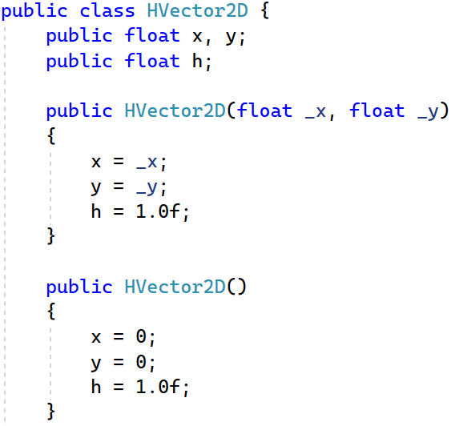
Here’s how that looks in code
Homogeneous coordinate, covered later when we look at matrices for games

Slide 27
Vectors can also be represented in Matrix form. In fact, a vector is a special case of a matrix.
e.g: Vector A = (3, 5, -2)
Vector A can be expressed as a 3x1 or 1x3 matrix:
Vector A = [3 5 -2]
3
5
-2
Vector A =
We’ll look at matrices in more detail later

Slide 28
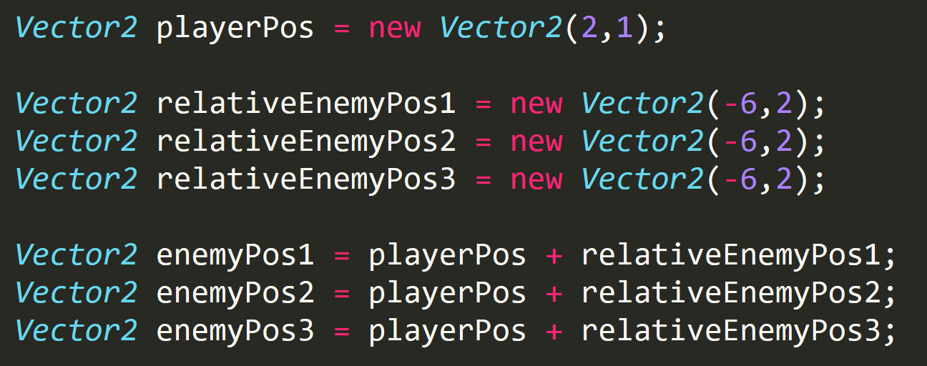
In Unity, points are represented as either Vector2 or Vector3 types
You’ll write your own Vector2D class later

Slide 29
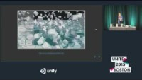
Let’s review …
Watch up to 5:59
https://www.youtube.com/watch?v=OOeA0pJ8Y2s&t=684s&ab_channel=Unity

Slide 30

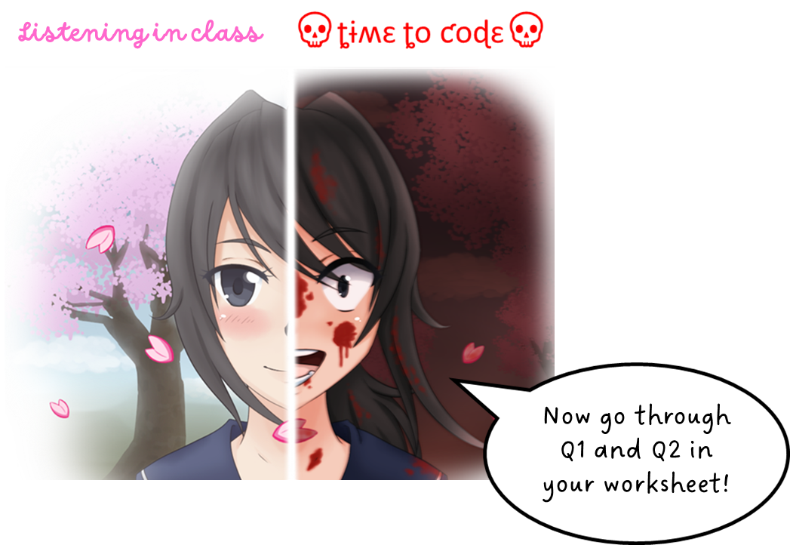
This health pack will keep your coding skills strong. Whenever you see this, it’s time for you to code!
We’ll implement the concepts as we go through the lectures slides.
GMAPS_Vectors_Worksheet.docx
If you have any questions, add them to this padlet
https://tinyurl.com/3r4k9m62

Slide 31
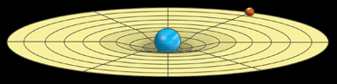
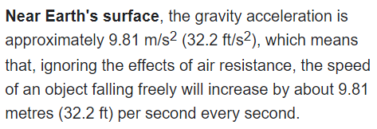
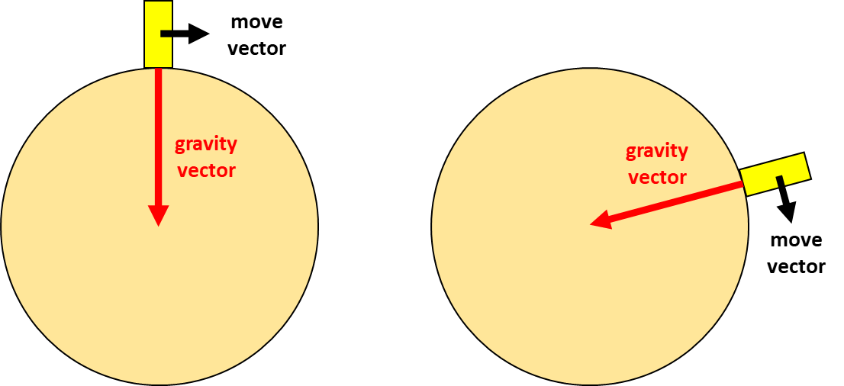
QUESTION 1 - Review
a) Share your game
b) What is gravity?
BIG question! Thoughts?
https://spaceplace.nasa.gov/what-is-gravity/en/
What is the magnitude of earth’s gravity?
The force of gravity varies with latitude and increases from about 9.780 m/s2 at the Equator to about 9.832 m/s2 at the poles.
https://en.wikipedia.org/wiki/Gravity_of_Earth
https://en.wikipedia.org/wiki/Gravity#Earth's_gravity
c) Is the gravity vector the same for all positions of Mario?
Magnitude is the same, but not direction

Slide 32
QUESTION 2 - Review
Any questions?
https://tinyurl.com/3r4k9m62

